Slide 1
Bellman-Ford algorithm
The Bellman-Ford algorithm is an example of Dynamic Programming.
It starts with a starting vertex and calculates the distances of other vertices which can be reached by one edge.
It then continues to find a path with two edges and so on.
The Bellman-Ford algorithm follows the bottom-up approach

Slide 2
Dynamic Programming is a powerful technique that can be used to solve many problems in time O(n2) or O(n3) for which a naive approach would take exponential time.
Dynamic Programming is a general approach to solving problem

Slide 3
Dynamic Programming
Basic Idea: The basic idea of Dynamic Programming is to find a way to break the problem down into a reasonable number of subproblems in such a way that we can use optimal solutions to the smaller subproblems to give us optimal solutions to the larger ones.
We just need the properties that:
(a) there are not too many subproblems overall, and
(b) there is some way of ordering our subproblems such that given the solutions to the subproblems solved so far, we can fairly quickly solve the next subproblem.
Then finally the last subproblem should be the original problem we wanted to solve (or something close enough to it that we can use our final subproblem to quickly solve the original problem).

Slide 4
BELLMAN-FORD(V, E, w, s)
INITIALIZE-SINGLE-SOURCE(V, s)
for i ← 1 to |V| - 1
do for each edge (u, v) ∈ E
do RELAX(u, v, w)
for each edge (u, v) ∈ E
do if d[v] > d[u] + w(u, v)
then return FALSE
return TRUE

Slide 5
Initialization
Alg.: INITIALIZE-SINGLE-SOURCE(V, s)
for each v ∈ V
do d[v] ← ∞
π[v] ← NIL
d[s] ← 0
All the shortest-paths algorithms start with INITIALIZE-SINGLE-SOURCE

Slide 6
Relaxation Step
Relaxing an edge (u, v) = testing whether we can improve the shortest path to v found so far by going through u
If d[v] > d[u] + w(u, v)
we can improve the shortest path to v
⇒ d[v]=d[u]+w(u,v)
⇒ π[v] ← u
u
v
u
v
5
2
9
5
2
6
After relaxation:
d[v] ≤ d[u] + w(u, v)
RELAX(u, v, w)
RELAX(u, v, w)
u
v
u
v
5
2
7
5
2
6
no change

Slide 7
Bellman-Ford Algorithm
Single-source shortest path problem
Computes δ(s, v) and π[v] for all v ∈ V
Allows negative edge weights - can detect negative cycles.
Returns TRUE if no negative-weight cycles are reachable from the source s
Returns FALSE otherwise ⇒ no solution exists

Slide 8
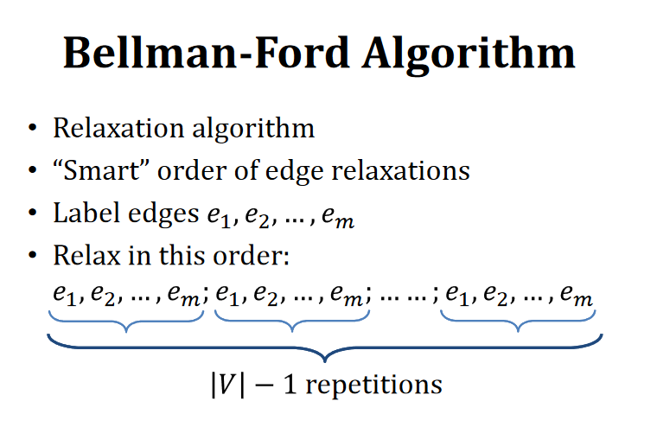

Slide 9
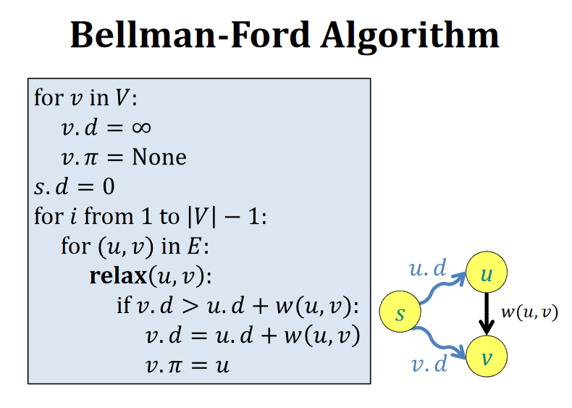

Slide 10
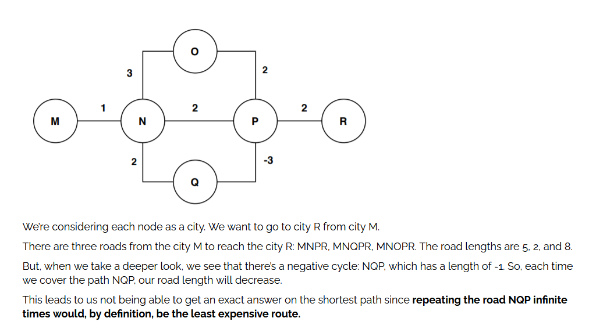
Negative cycles

Slide 11
Negative cycles
What is the shortest path from a to e?
1
1
B
D
A
5
10
-10
C
E
3

Slide 12
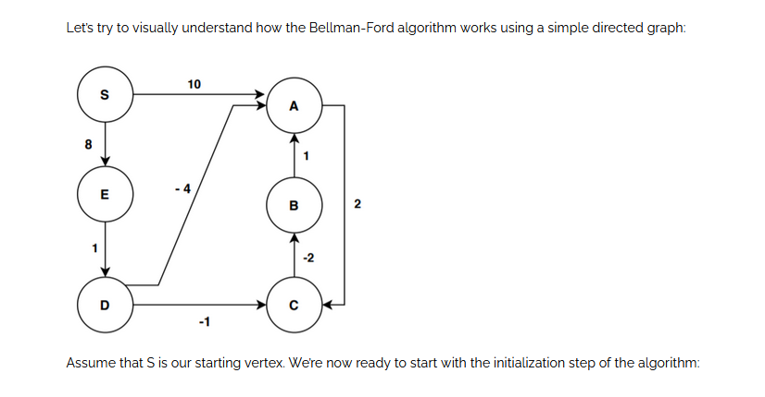
A Graph Without Negative Cycle

Slide 13
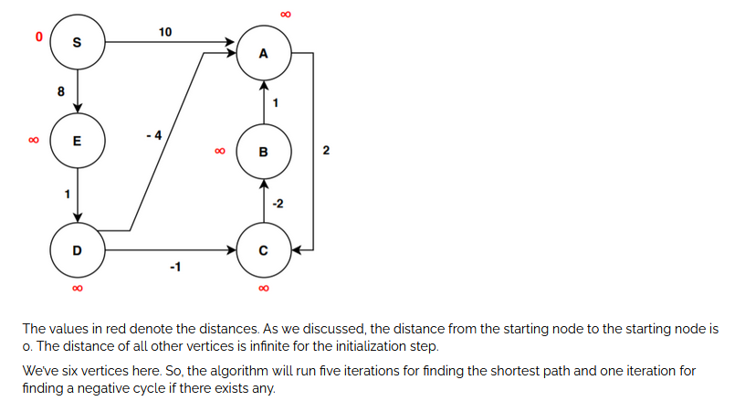
Bellman Ford Algorithm Example

Slide 14
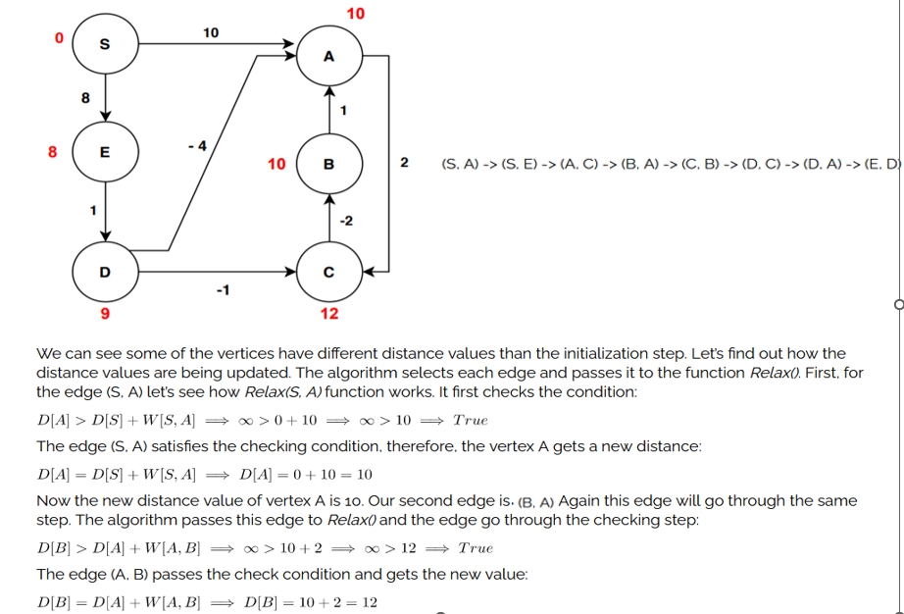
First Iteration

Slide 15
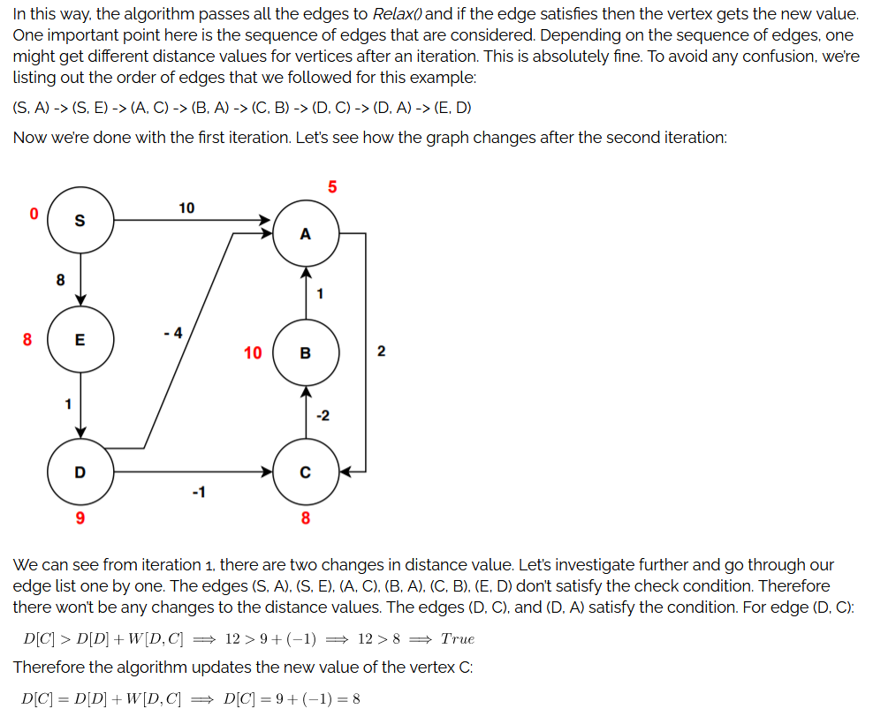
Iteration 1

Slide 16
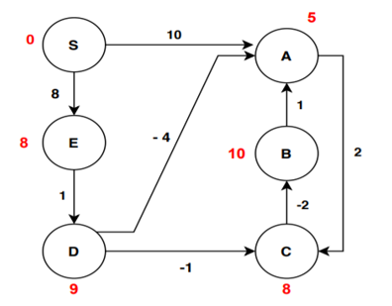
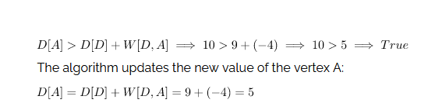
Edge (D,A)

Slide 17
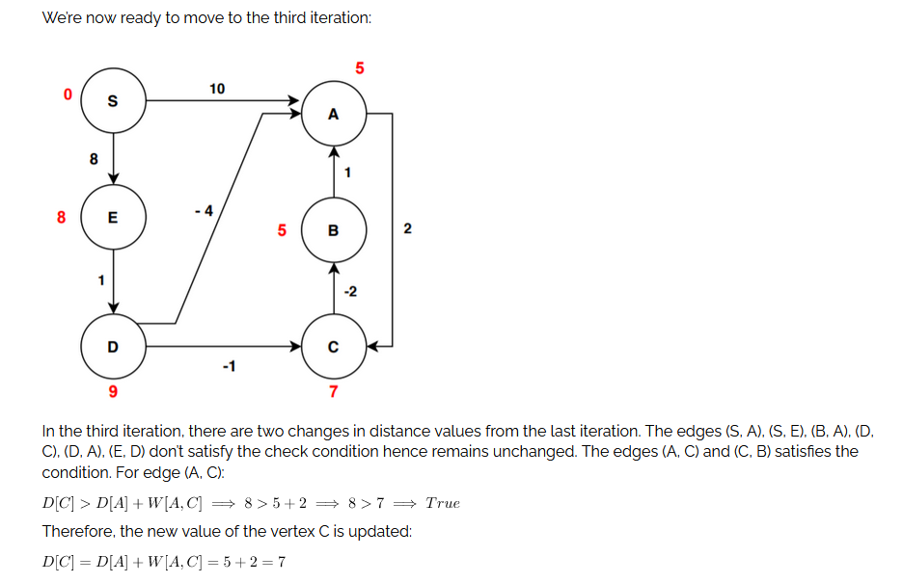
Iteration 3

Slide 18
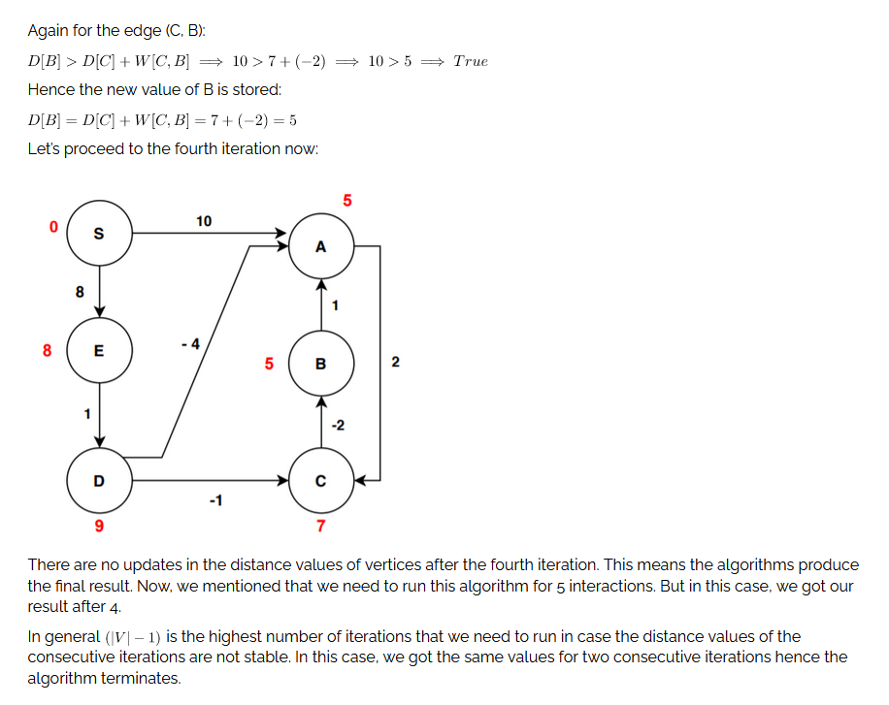
Iteration 4

Slide 19
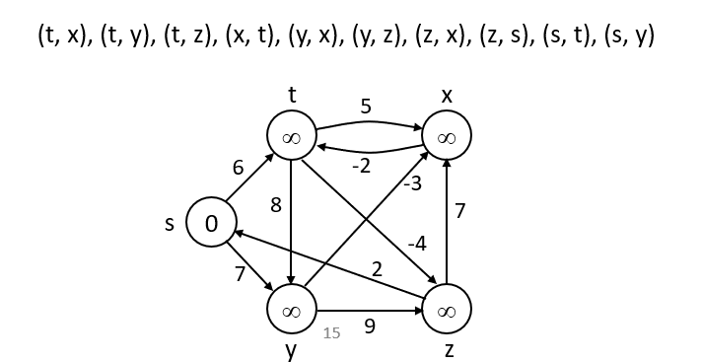
Bellman-Ford Algorithm - Example
Idea:
Each edge is relaxed |V–1| times by making |V-1| passes over the whole edge set.
To make sure that each edge is relaxed exactly |V – 1| times, it puts the edges in an unordered list and goes over the list |V – 1| times.

Slide 20
BELLMAN-FORD(V, E, w, s)
t
5
x
Pass 1
t
5
x
∞
∞
∞
∞
6
6
-2
-3
6
-2
-3
s
0
8
7
s
0
8
7
-4
-4
7
2
7
2
∞
∞
∞
∞
9
7
9
y
z
y
z
E: (t, x), (t, y), (t, z), (x, t), (y, x), (y, z), (z, x), (z, s), (s, t), (s, y)

Slide 21
Example
(t, x), (t, y), (t, z), (x, t), (y, x), (y, z), (z, x), (z, s), (s, t), (s, y)
t
5
x
t
5
x
Pass 1
(from
previous
slide)
6
∞
Pass 2
6
∞
4
11
6
-2
-3
6
-2
8
8
-3
s
0
7
s
0
7
-4
-4
7
2
7
2
7
∞
7
∞
9
9
2
y
z
y
z
Pass 3
t
5
x
Pass 4
t
5
x
6
∞
6
∞
2
4
11
2
4
11
6
-2
-3
6
-2
-3
s
0
8
7
s
0
8
7
-4
-4
7
2
7
2
7
∞
7
∞
2
2
9
9
-2
y
z
y
z

Slide 22
Detecting Negative Cycles (perform extra test after V-1 iterations)
for each edge (u, v) ∈ E
do if d[v] > d[u] + w(u, v)
then return FALSE
return TRUE
s
b
0
2
∞
-8
3
∞
c
1st pass
2nd pass
s
b
s
b
Look at edge (s, b):
d[b] = -1
d[s] + w(s, b) = -4
⇒ d[b] > d[s] + w(s, b)
0
2
∞
-3
2
2
-3
2
-6
-1
-8
3
-8
3
∞
5
5
2
c
c
(s,b) (b,c) (c,s)

Slide 23
BELLMAN-FORD(V, E, w, s)
INITIALIZE-SINGLE-SOURCE(V, s)
for i ← 1 to |V| - 1
do for each edge (u, v) ∈ E
do RELAX(u, v, w)
for each edge (u, v) ∈ E
do if d[v] > d[u] + w(u, v)
then return FALSE
return TRUE
Running time: O(V+VE+E)=O(VE)
Θ(V)
O(V)
O(VE)
O(E)
O(E)

Slide 24
Bellman-Ford Example
0
∞
10
S
A
Iteration: 0
8
1
∞
∞
G
-4
B
2
1
1
-2
C
∞
F
∞
-1
3
E
D
-1
∞
∞

Slide 25
Bellman-Ford algorithm
0
10
10
S
A
Iteration: 1
8
1
∞
8
G
-4
B
2
1
1
-2
C
∞
F
∞
-1
3
E
D
-1
∞
∞

Slide 26
Bellman-Ford algorithm
0
10
10
S
A
Iteration: 2
8
1
∞
8
G
-4
B
2
1
1
-2
C
∞
F
9
-1
3
E
D
-1
12
∞

Slide 27
Bellman-Ford algorithm
0
5
10
S
A
Iteration: 3
8
1
10
8
G
-4
B
A has the correct distance and path
2
1
1
-2
C
∞
F
9
-1
3
E
D
-1
8
∞

Slide 28
Bellman-Ford algorithm
0
5
10
S
A
Iteration: 4
8
1
6
8
G
-4
B
2
1
1
-2
C
11
F
9
-1
3
E
D
-1
7
∞

Slide 29
Bellman-Ford algorithm
0
5
10
S
A
Iteration: 5
8
1
5
8
G
-4
B
B has the correct distance and path
2
1
1
-2
C
7
F
9
-1
3
E
D
-1
7
14

Slide 30
Bellman-Ford algorithm
0
5
10
S
A
Iteration: 6
8
1
5
8
G
-4
B
2
1
1
-2
C
6
F
9
-1
3
E
D
-1
7
10

Slide 31
Bellman-Ford algorithm
0
5
10
S
A
Iteration: 7
8
1
5
8
G
-4
B
D (and all other nodes) have the correct distance and path
2
1
1
-2
C
6
F
9
-1
3
E
D
-1
7
9

Slide 32
References
https://www.geeksforgeeks.org/bellman-ford-algorithm-dp-23/
https://www.javatpoint.com/bellman-ford-algorithm
https://www.scaler.com/topics/data-structures/bellman-ford-algorithm/

